Slide 1

Vulnerability Assessment of Deep Reinforced Learning Models for Power System Topology Optimization
Paper Authors: Yan Zheng, Ziming Yan, Kangjie Chen, Jianwen Sun, Yan Xu and Yang Liu

Slide 2
CONTENTS
INTRODUCTION
PROBLEM DESCRIPTIONS
CRITICALITY-BASED ADVERSIAL PERTURBATION
VULNERABILITY INDICES
SIMULATION RESULTS
CONCLUSION

Slide 3
SECTION I: INTRODUCTION
Motivation
Problem
Limited research on DRL Vulnerability assessment in Power systems
Proposed Solution
Criticality-Based Perturbations
DRL Vulnerable to cyber attacks and data perturbations
Vulnerability Indices
Targeted users
Grid operators - Safe grid operations
Complex Power Grids
Insufficiency of Traditional Methods
Notes:
Complex power grids -> inclusion of renewable energy integration and deregulation
Traditional methods -> old (DRL offers Promise)
Criticality-Based Perturbations -> is developed to find out vulnerabilities
Vulnerability Indices -> to assess the impact of perturbations

Slide 4
SECTION II: PROBLEM DESCRIPTIONS
DRL for Network Topology Optimization
Focus on Optimizing Power flow by switching transmission lines or disconnecting loads
Achieved using DRL agents
That interacts
Power System Agent

Slide 5
SECTION II: PROBLEM DESCRIPTIONS
Technical Details
Describes objective function
Maximizes
Remaining Transfer Capabilities
Power flow solution using power flow equations
Markov Decision Process (MDP) is used to formulate the decision-making process
Power Flow divergence and satisfies transmission line limits
Reward function
Penalizes
Deep Q Neural Network (DQN)
Train
DRL Agent to find Optimal Policy

Slide 6
SECTION II: PROBLEM DESCRIPTIONS
Perturbation-Based DRL Vulnerability Assessment
Highlight of potential vulnerability of DRL Models to potential small data perturbations
Pointers on existing research on adversarial attacks against DRL Models
Intro. of the concept of perturbation-based assessment
Formulates equations for adding perturbations and the DRL’s response

Slide 7
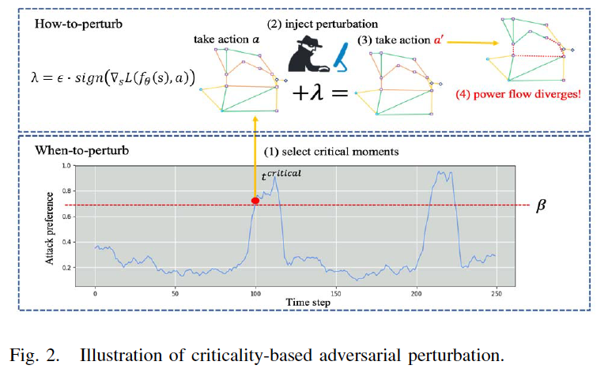
SECTION III: CRITICALITY-BASED ADVERSARIAL PERTURBATION

Slide 8
SECTION III: CRITICALITY-BASED ADVERSARIAL PERTURBATION
WHEN TO PERTURB
⚫️ Critical moment identification
⚫️ Model -> Calculating attacker-preference value
⚫️ Higher preference values
HOW TO PERTURB
⚫️ Focus on crafting effective perturbations
⚫️ Model leverages Fast Gradient Sign Method (FGSM)

Slide 9
SECTION III: CRITICALITY-BASED ADVERSARIAL PERTURBATION
KEY POINTS
Limitation of real power grid
Minimizing number of perturbations
Optimal Time to inject perturbation
Generating perturbations maximizing Model’s loss function

Slide 10
SECTION IV: VULNERABILITY INDICES
Probability-Based Criteria
Assess overall vulnerability of DRL systems
Failure Rate
Percentage of testcases where power flow diverges
Higher Failure rate = Greater Vulnerability
EPD and EPDR
Measuring average decrease in control reward
Larger Decrease = Higher Vulnerability

Slide 11
SECTION IV: VULNERABILITY INDICES
Gradient-Based Criteria
Focus on specific states
Sensitivity :: Perturbations
Importance of DRL agent’s chosen action
Larger p-function = more critical action
Gradient Saliency (GS)
Higher GS = Greater Vulnerability
P-function

Slide 12
SECTION IV: VULNERABILITY INDICES
In Summary
vulnerability
Power Systems
vulnerability
Quantifying based
on
different aspects
Overall Performance Degradation
Sensitivity to Perturbations

Slide 13
SECTION V: SIMULATION RESULTS
Application on:
14-bus system
IEEE 118-bus system

Slide 14
SECTION V: SIMULATION RESULTS
Evaluation Method
DRL Controller Performance
No Perturbations
Metrics - Accessing Vulnerabilities
Random Noise Perturbations
Targeted Attacks (FGSM and Criticality-based)
Critical Attack Rate (CAR)
EPD and EPDR
Action Preference (p-function)
Gradient Saliency (GS)

Slide 15
SECTION V: SIMULATION RESULTS
KEY FINDINGS
DRL CONTROLLER PERFORMANCE
PROPOSED METHOD
P-FUNCTION > GS
Degrades with FGSM and Criticality based attacks
No degrade with no perturbations and random noise
Higher efficiency over FGSM
Since, fewer attacks achieve similar performance
CRITICALITY-BASED APPROACH
Higher Critical Attack Rate compared to FGSM
Prediction of potential DRL malfunction before they occur
GS - not effective
Impact of attacks is more severe with the 14-bus system vs 118-bus system

Slide 16
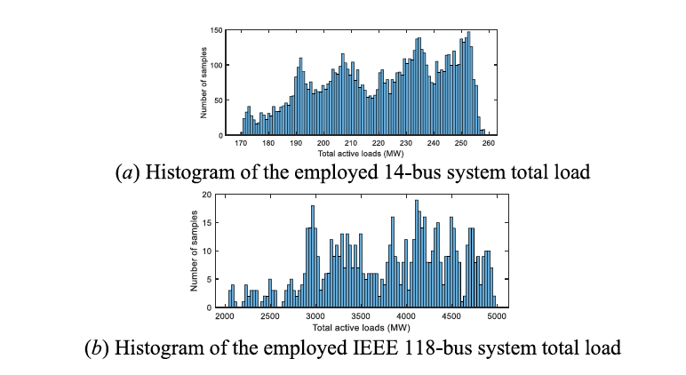
SECTION V: SIMULATION RESULTS
Impact of attacks is more severe with the 14-bus system vs 118-bus system

Slide 17
SECTION VI: CONCLUSION
Criticality-based adversarial perturbation model effective
Small size of perturbation
Attacker-Preference Value
Overall Performance and Operational Vulnerability
Demonstrated through Simulations
p-function value - effective indicator

Slide 18
SECTION VI: CONCLUSION
Future Work suggestions
Investigating Methods to Protect Power Grids from Attackers that can dynamically switch between different attacks strategies

Slide 19

Thank you for your patience ☺

